Slide 1
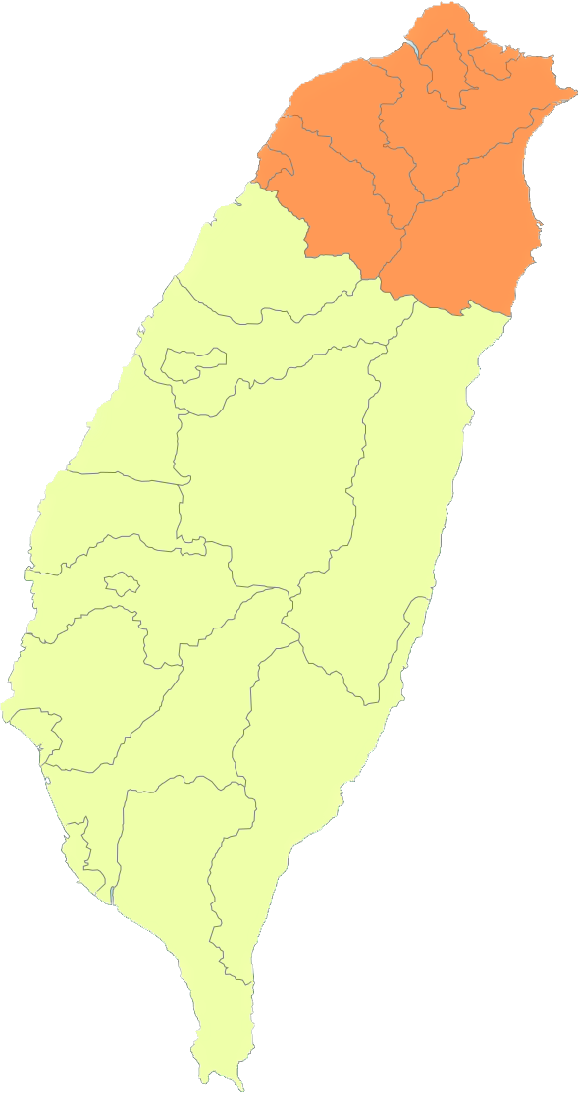

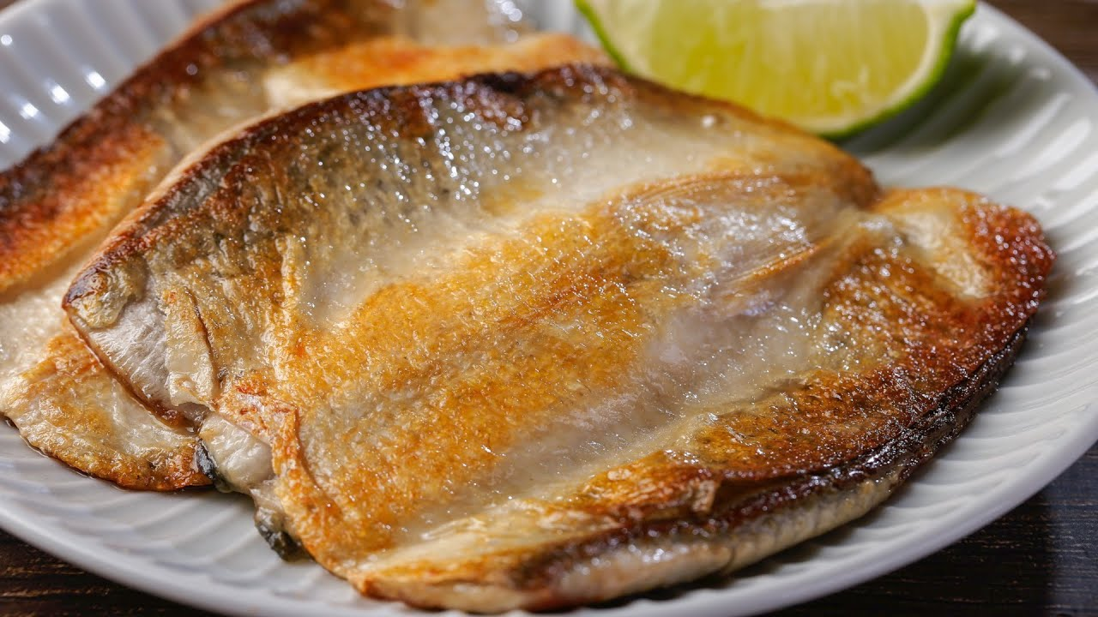
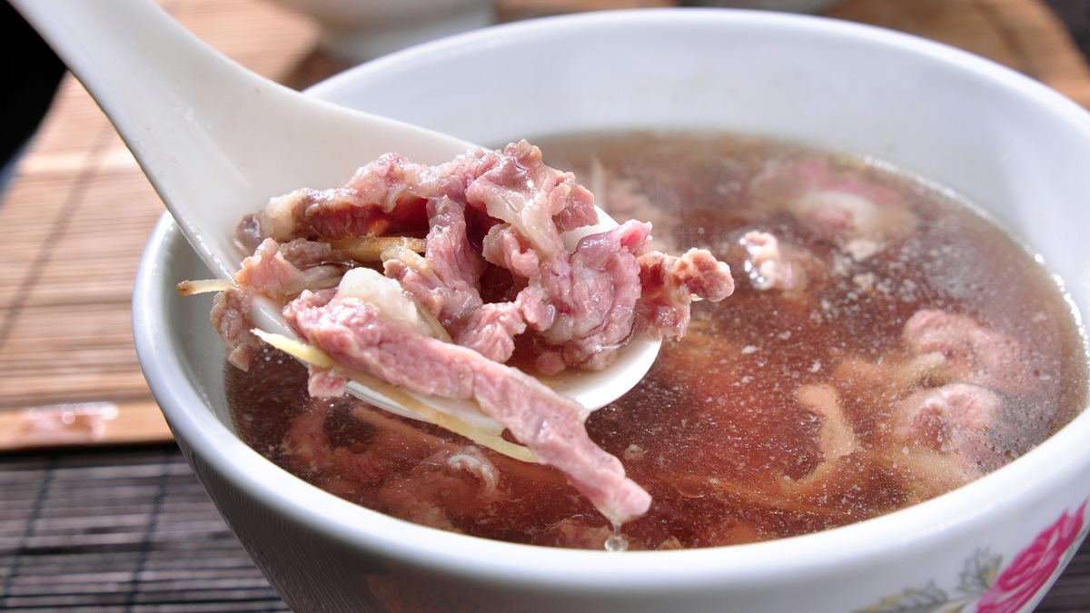
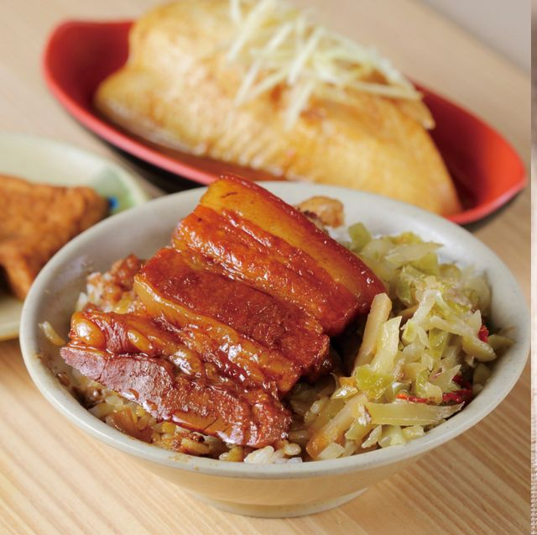





Taiwan Xiao-Chi
Differ between Northern and Southern Xiao-Chi
Northern Xiao-Chi
Southern Xiao-Chi
Shopping List
Southern Xiao-Chi
The yellow region is southern of Taiwan, the ancestors of residents here could be traced back to Ming and Qing dynasty, no to mention they had been under Japanese colonization for fifty years next. Therefore, ordinarily southern Xiao-Chi is considered has more Taiwanese and more kinds of cuisine than northern Xiao-Chi.
In Qing dynasty and Japanese colonization period, southern of Taiwan is a famous place for sugar production.
With the time passes, sugar has become a symbol of richness because sugar production bought a lot of cash flow to southern Taiwanese resident. As a result, southern residents began to add sugar into the cuisine, yet lead southern Xiao-Chi are much sweeter than northern Xiao-Chi.
Milk Fish Cuisine
Beef Soup
Khong Bah Png
Taiwan Xiao-Chi
Northern Xiao-Chi
Southern Xiao-Chi
Differ Between northern and Southern Xiao-Chi
Shopping List

